Slide 1
No Pain, No Gain: Understanding Muscle Pain
Jankowski Lab – Anesthesia/Pain Management
Jordan Lamb

Slide 2
Project Description
Goal – Better understand molecular mechanisms that lead to muscle pain after injury in order to determine better treatments for musculoskeletal pain
Muscle-specific injury model in mice
Block blood flow in right forepaw by tying off brachial artery (Ischemia)
Remove blockage after several hours to allow blood flow again (reperfusion)
Causes changes in the muscle tissue and in gene expression in afferent neurons that carry pain input from muscle to CNS

Slide 3
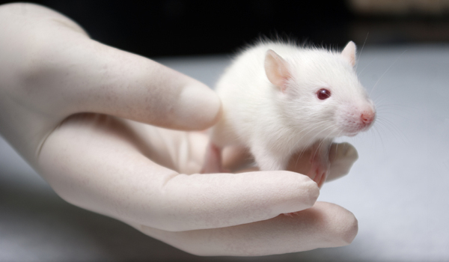
Project Description Cont.
Three types of procedures to study pain produced after injury
Behavior – guarding, grip strength, threshold they respond to mechanical stimuli
Electrophysiological recording – responsiveness to mechanical, thermal, and chemical muscle stimulation
Molecular Assays
My role
Focus on molecular assays
Real-time PCR analysis

Slide 4
What? So What? Now What?
Basic laboratory skills – pipetting, weighing chemicals, preparing solutions, mouse handling, etc.
Exposed to variety of different procedures
RNA isolation, protein isolation, reverse transcription, PCR, cell culture
Assist with animal surgery
About myself
Like working in structured environment – following procedure
Gaining independence
Asking for help

Slide 5
What? So What? Now What?
Bettering understanding of neuroscience
Classroom and daily life
Chance to explore other science/medicine related careers
Perceptions on research process
A LOT of work
More respect
Prepared to continue research this summer and in the future

